Slide 1
Radar and Navigational Aids (18ECE221T) . UNIT – 4. Radar Transmitter and Receiver . Sessions – 4, 5, 6.
Prepared by,
Dr. Diwakar R. Marur

Slide 2
Note As for “Session 4” is concerned elementary treatment is sufficient

Slide 3
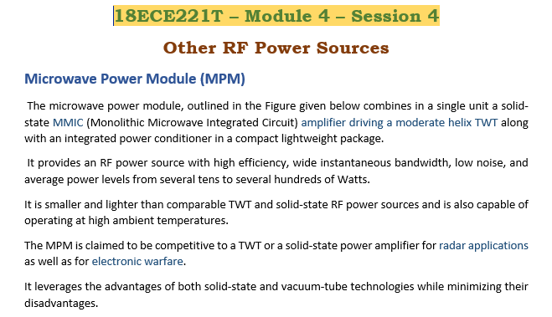

Slide 4
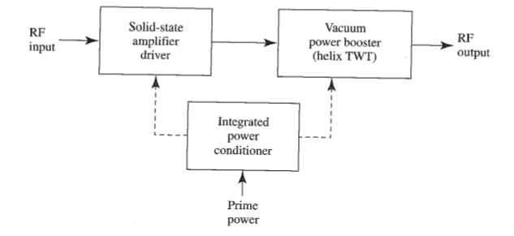

Slide 5
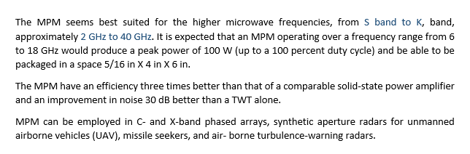
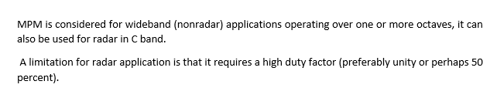

Slide 6
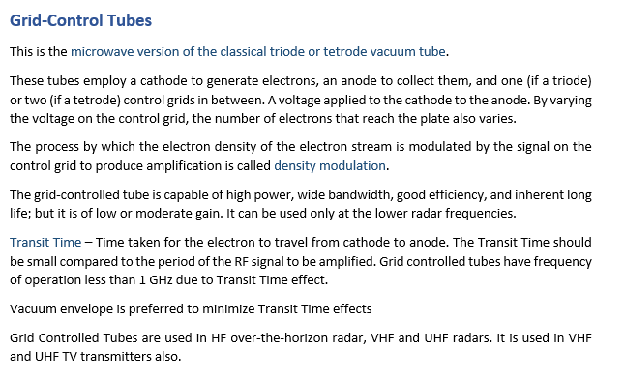

Slide 7
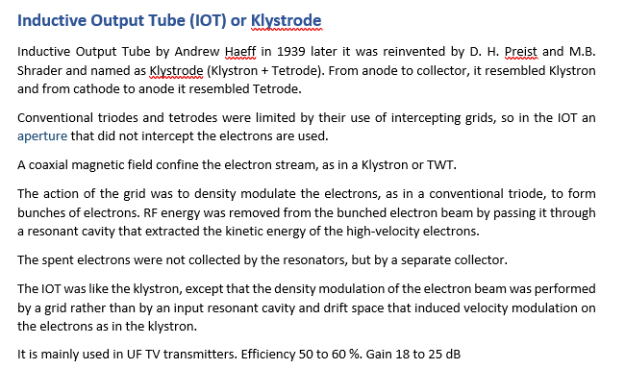

Slide 8
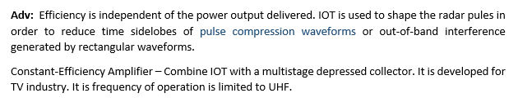

Slide 9
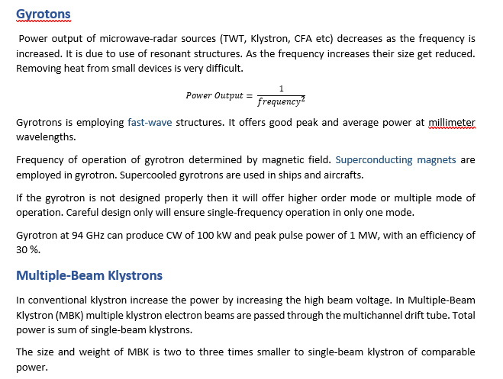

Slide 10
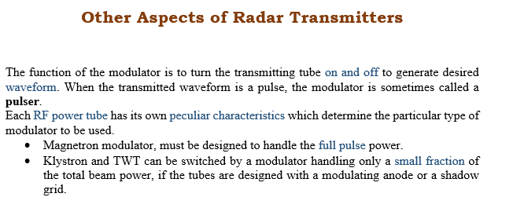

Slide 11
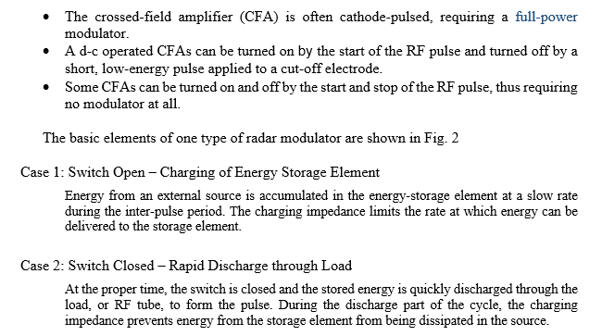

Slide 12
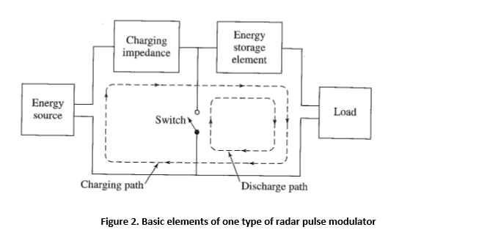

Slide 13
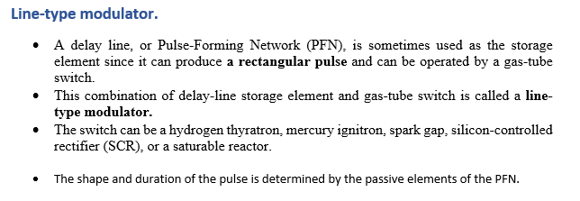
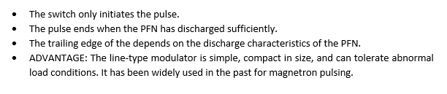

Slide 14
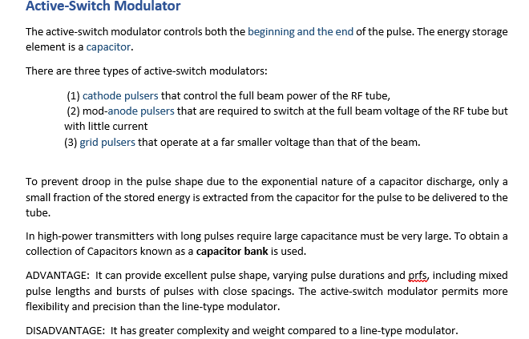

Slide 15
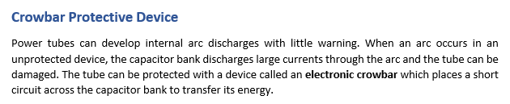
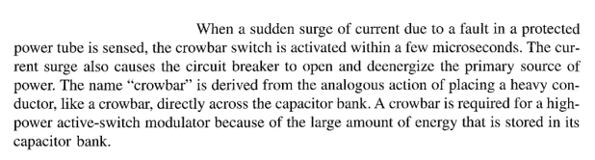

Slide 16
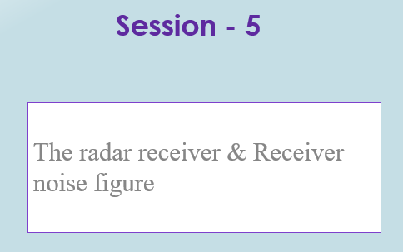

Slide 17
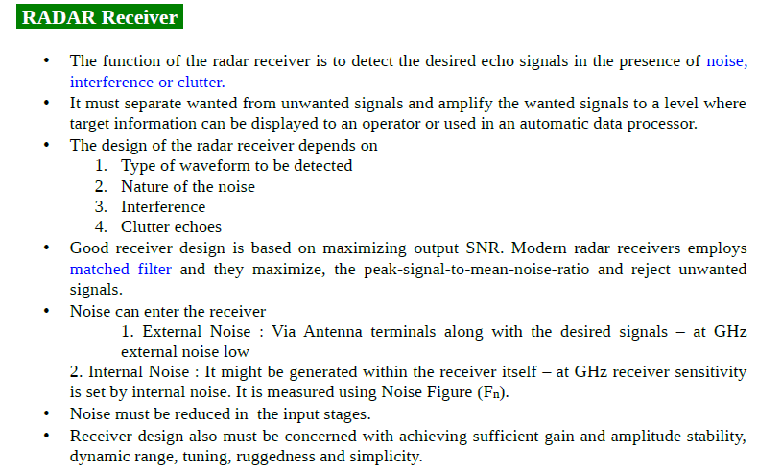

Slide 18
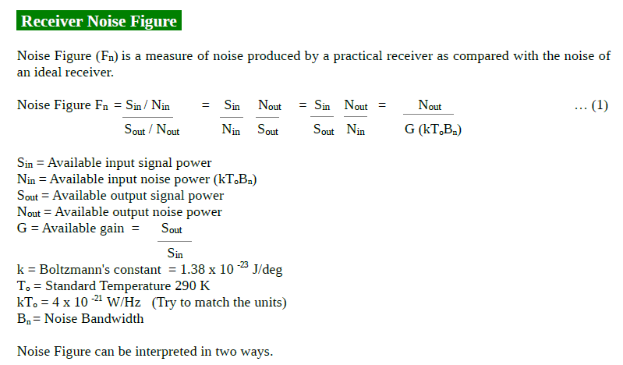

Slide 19
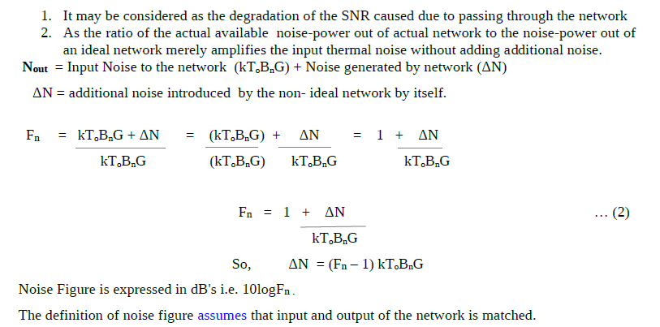

Slide 20
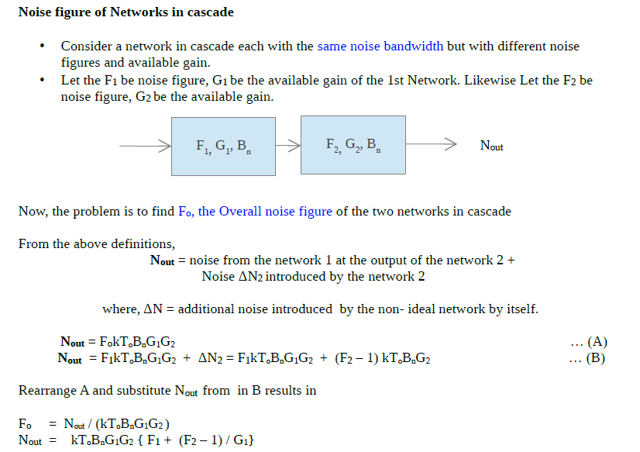

Slide 21
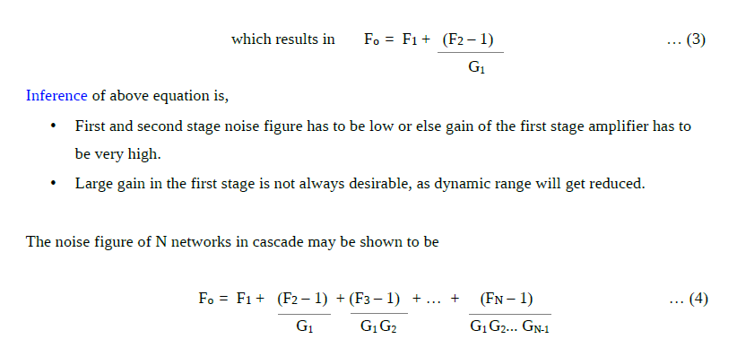

Slide 22
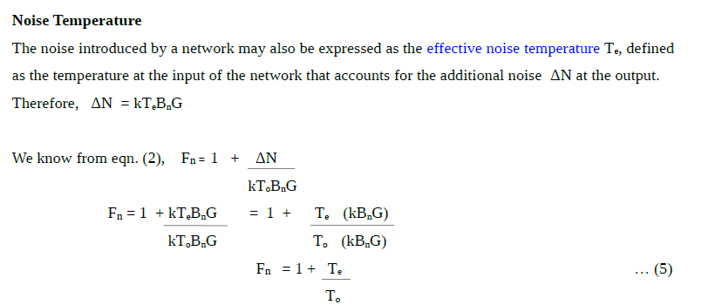
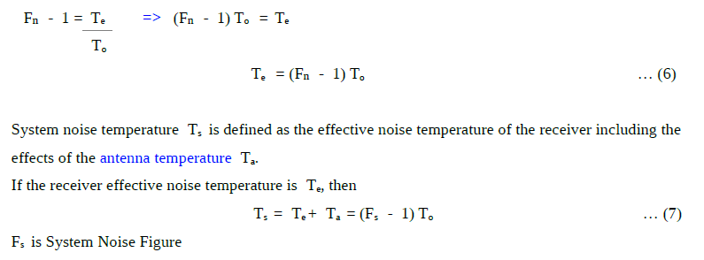

Slide 23
Reference Material for Noise Figure
[1] Noise Power, Noise Figure and Noise Temperature by Sujeong Lee
https://cpb-usw2.wpmucdn.com/u.osu.edu/dist/0/890/files/2013/12/noise_SujeongLee-2gxokr2.pdf

Slide 24
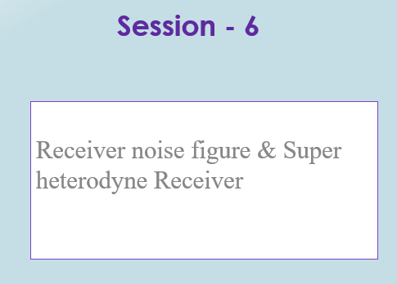

Slide 25
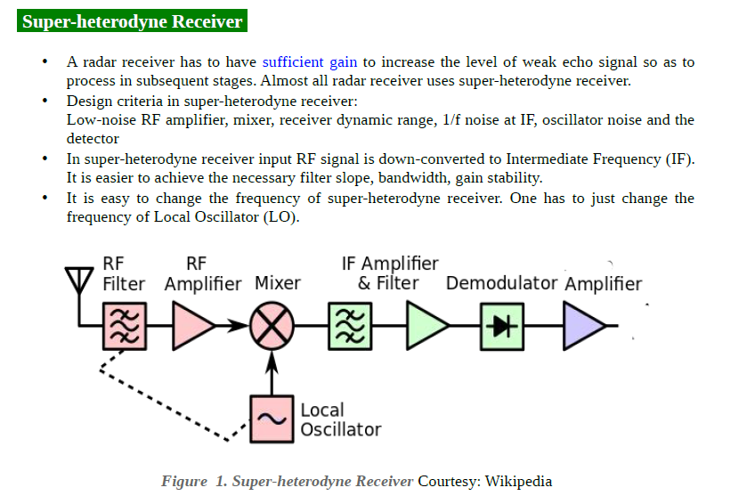

Slide 26
Text Book
Merrill I. Skolnik, “Introduction to Radar Systems”, 3rd Edition, Tata Mc Graw-Hill 2008.

Slide 27
Thank You

